Slide 1
Transport Layer and TCP

Slide 2
5. Datagram fragmentation and reassembly is handled by IP, and is invisible to TCP. Does this mean that TCP does not have to worry about data arriving in the wrong order?
Even though each datagram arrives intact, it is possible that datagrams arrive in the wrong order, so TCP has to be prepared to reassemble the parts of a message properly.

Slide 3
2. A client sends a 128-byte RPC request to a server located 100km away over a 1-gigabit optical fiber. What is the efficiency of the line during the remote procedure call? (propagation speed is 2/3 of light speed)
Sending 1000 bits over a 1 Gbps line takes 1 µsec. The speed of light in fiber optics is 200 km/msec, so it takes 0.5 msec for the request to arrive and another 0.5 msec for the reply to get back. In all, 1000 bits have been transmitted in 1 msec. This is equivalent to 1 megabit/sec, or 0.1% efficiency.

Slide 4
3. Consider the situation of the previous problem again. Compute the minimum possible response time both for the given 1-Gbps line and for a 1-Mbps line. What conclusion can you draw?
At 1 Gbps, the response time is determined by the speed of light. The best that can be achieved is 1 msec. At 1 Mbps, it takes about 1 msec to pump out the 1024 bits, 0.5 msec for the last one to get to the server, and 0.5 msec for the reply to get back in the best case. The best possible RPC time is then 2 msec. The conclusion is that improving the line speed by a factor of 1000 only wins a factor of two in performance. Unless the gigabit line is amazingly cheap, it is probably not worth having for this application.

Slide 5
8. A TCP machine is sending windows of 65,535 bytes over a 1-Gbps channel that has a 10-msec one-way delay. What is the maximum throughput achievable? What is the line efficiency?
One window can be sent every 20 msec. This gives 50 windows/sec, for a maximum data rate of about 3.3 million bytes/sec. The line efficiency is then 26.4 Mbps/1000 Mbps or 2.6 percent.

Slide 6
11. Calculate the bandwidth-delay product for the following networks: (1) T1 (1.5 Mbps), (2) Ethernet (10Mbps), (3) T3 (45 Mbps), and (4) STS-3 (155 Mbps). Assume an RTT of 100 msec. Recall a TCP header has 16 bits reserved for Window Size. What are its implications in light of your calculations?
The answer are: (1) 18.75 KB, (2) 125 KB, (3) 562.5 KB, (4) 1.937 MB.
A 16-bit window size means a sender can send at most 64 KB before having to wait for an acknowledgement. This means that a sender cannot transmit continuously using TCP and keep the pipe full if the network technology used is Ethernet, T3, or STS-3.

Slide 7
12. What is the bandwidth-delay product for a 50-Mbps channel on a geostationary satellite? If the packets are all 1500 bytes (including overhead), how big should the window be in packets?
The round-trip delay is about 540 msec
so with a 50 Mbps channel the bandwidth-product delay is 27 megabits or 3,375,000 bytes. With packets of 1500 bytes, it takes 2250 packets to fill the pipe, so the window should be at least 2250 packets.

Slide 8
Why does UDP exist? Would it not have been enough to just let user processes send raw IP packets?
No. IP packets contain IP addresses, which specify a destination machine. Once such a packet arrived, how would the network handler know which process to give it to? UDP packets contain a destination port. This information is essential so they can be delivered to the correct process.

Slide 9
4. Both UDP and TCP use port numbers to identify the destination entity when delivering a message. Give two reasons for why these protocols invented a new abstract ID (port number), instead of using process IDs, which already existed when these protocols were designed.
Here are three reasons. First, process IDs are OS-specific. Using process IDs would have made these protocols OS-dependent. Second, a single process may establish multiple channels of communications. A single process ID (per process) as the destination identifier cannot be used to distinguish between these channels. Third, having processes listen on well-known ports is easy, but well-known process IDs are impossible.

Slide 10
6. Consider the effect of using slow start on a line with a 10-msec round-trip time and no congestion. The receive window is 24 KB and the maximum segment size is 2KB. How long does it take before the first full window can be sent?

Slide 11
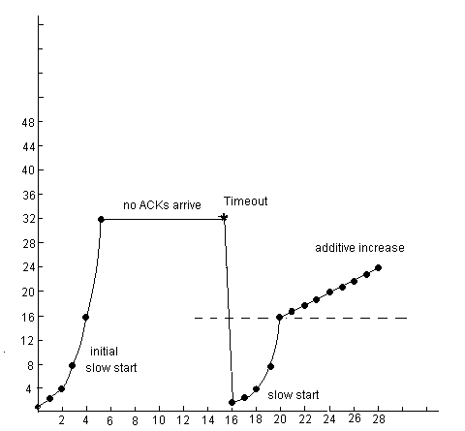
packets

Slide 12
packets

Slide 13
packets

Slide 14
packets

Slide 15
6. Consider the effect of using slow start on a line with a 10-msec round-trip time and no congestion. The receive window is 24 KB and the maximum segment size is 2KB. How long does it take before the first full window can be sent?
The first bursts contain 2K, 4K, 8K, and 16K bytes, respectively. The next one is 24 KB and occurs after 40 msec.

Slide 16
7. Suppose that the TCP congestion window is set to 18 KB and a timeout occurs. How big will the window be if the next four transmission bursts are all successful? Assume that the maximum segment size is 1 KB.
The next transmission will be 1 maximum segment size. Then 2, 4, and 8. So after four successes, it will be 8 KB.

Slide 17
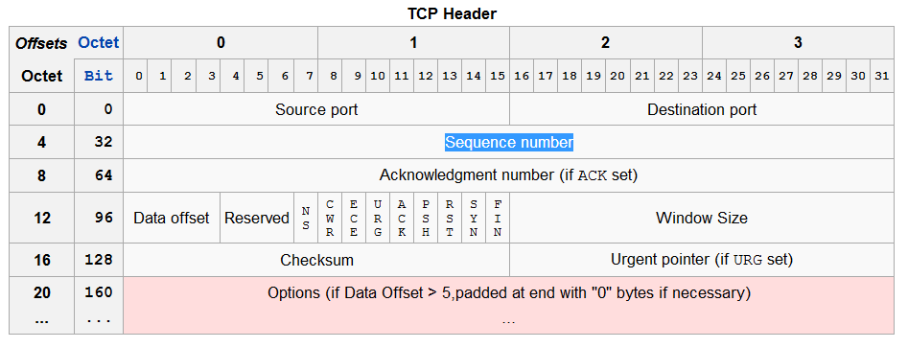
9. What is the fastest line speed at which a host can blast out 1500-byte TCP payloads with a 120-sec maximum packet lifetime without having the sequence numbers wrap around? Take TCP, IP, and Ethernet overhead into consideration. Assume that Ethernet frames may be sent continuously.

Slide 18
9. What is the fastest line speed at which a host can blast out 1500-byte TCP payloads with a 120-sec maximum packet lifetime without having the sequence numbers wrap around? Take TCP, IP, and Ethernet overhead into consideration. Assume that Ethernet frames may be sent continuously.
The goal is to send 2^32 bytes in 120 sec or 35,791,394 payload bytes/sec. This is 23,860 1500-byte frames/sec. The TCP overhead is 20 bytes. The IP overhead is 20 bytes. The Ethernet overhead is 26 bytes. This means that for 1500 bytes of payload, 1566 bytes must be sent. If we are to send 23,860 frames of 1566 bytes every second, we need a line of 299 Mbps. With anything faster than this we run the risk of two different TCP segments having the same sequence number at the same time.

Slide 19
10. To get around the problem of sequence numbers wrapping around while old packets still exist, one could use 64-bit sequence numbers. However, theoretically, an optical fiber can run at 75 Tbps. What maximum packet lifetime is required to make sure that future 75 Tbps networks do not have wraparound problems even with 64-bit sequence numbers? Assume that each byte has its own sequence number, as TCP does.
The size of the sequence space is 2^ 64 bytes, which is about 2 × 10^19 bytes. A 75 Tbps transmitter uses up sequence space at a rate of 9.375 × 10^12 sequence numbers per second. It takes 2 million seconds to wrap around. Since there are 86,400 seconds in a day, it will take over 3 weeks to wrap around, even at 75 Tbps. A maximum packet lifetime of less than 3 weeks will prevent the problem. In short, going to 64 bits is likely to work for quite a while.

